Slide 1
IETF Hackathon
IETF 93, July 18-19,
Prague, Czech Republic

Slide 2
Goals
Running Code (RFC 6982)
Open Source
Speed and Relevance of Standards
Collaborate and Learn
Have Fun
Cookies!!!

Slide 3
Technologies
Authentication and Authorization for Constrained Environments (ACE)
BIER (Bit Index Explicit Replication)
DANE / DNS Privacy / DNSSEC
DHCPv6 (Dynamic Host Configuration Protocol for IPv6)
HOMENET – auto config for IPv6 routed home networks
HTTP/2.0
NETCONF/YANG, I2RS, OpenDaylight
NETVC (Internet Video Codec) and Daala, Thor
MPTCP (Multi-Path TCP)
OpenWSN/6TiSCH/Cryptech: implementing Internet of (Important) Things
RPKI (Resource Public Key Infrastructure)
RIOT (OS for internet of things)
SCTP (Stream Control Transmission Protocol)
SFC in OpenDaylight
SPUD (Substrate Protocol Underneath Datagrams)

Slide 4
Collaborate on Code https://github.com/eckelcu/ietf-hackathon
Git/GitHub commonly used for open source projects
Getting started:
Install Git on laptop https://help.github.com/articles/set-up-git/
Join Hackathon repo https://github.com/eckelcu/ietf-hackathon
Working on existing project, or add a new one, by forking https://help.github.com/articles/fork-a-repo/
“Follow” team members and “watch” project(s) https://help.github.com/articles/be-social/
More info: http://gitref.org

Slide 5
Bits-N-Bites
Table for Hackathon Projects
Show off what you did
Thursday, 19:15 – 21:15
Congress Hall Foyer
Food and drinks provided

Slide 6
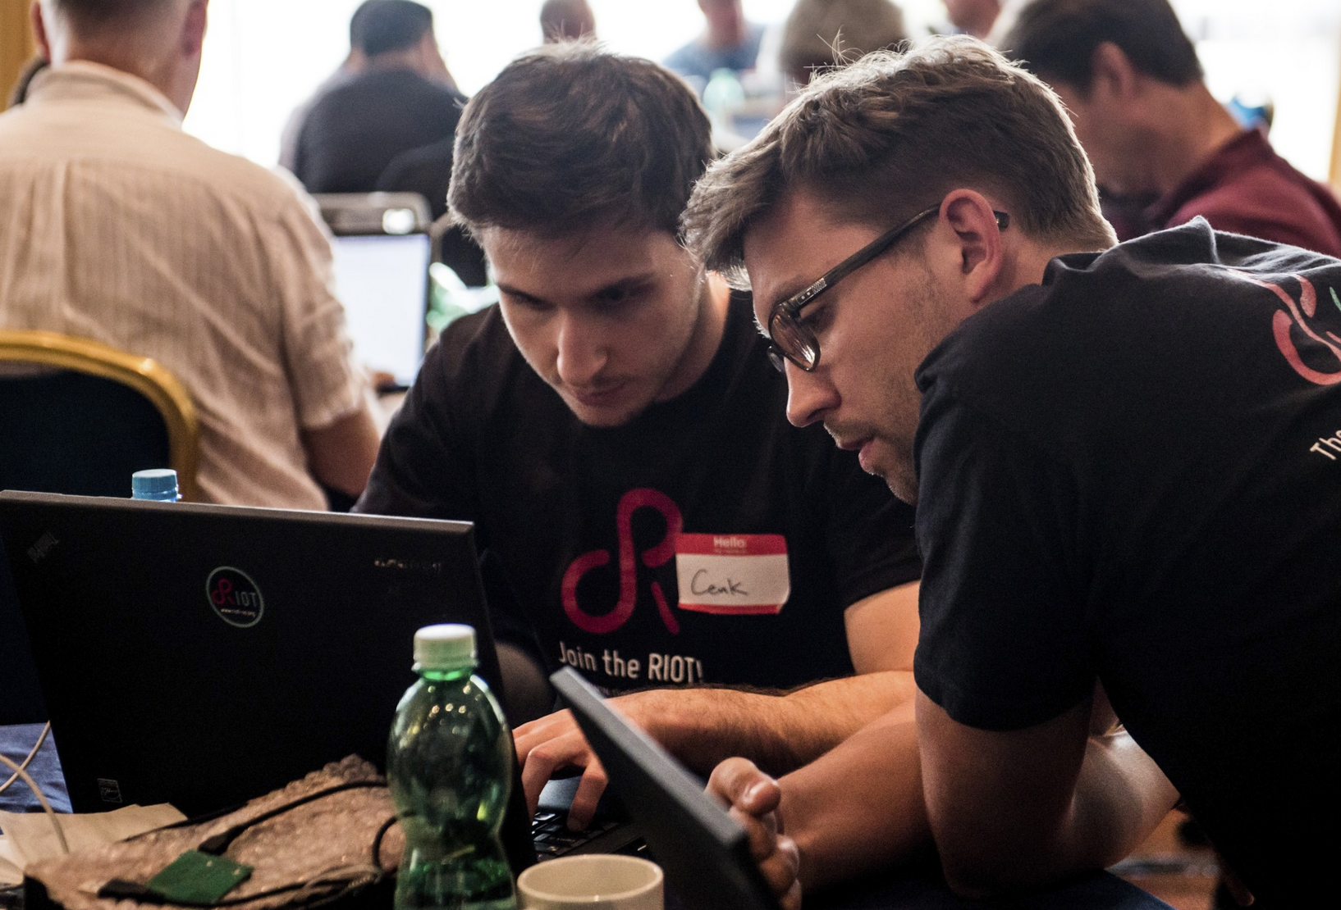
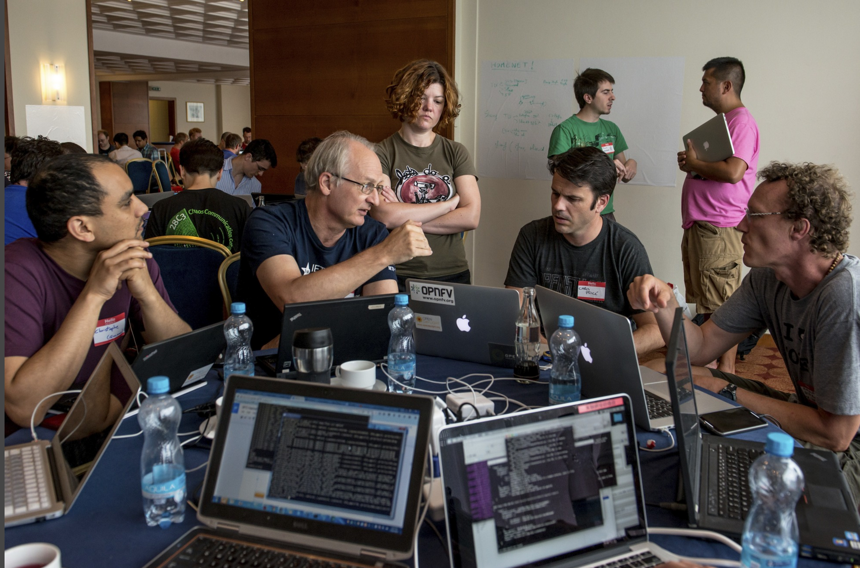
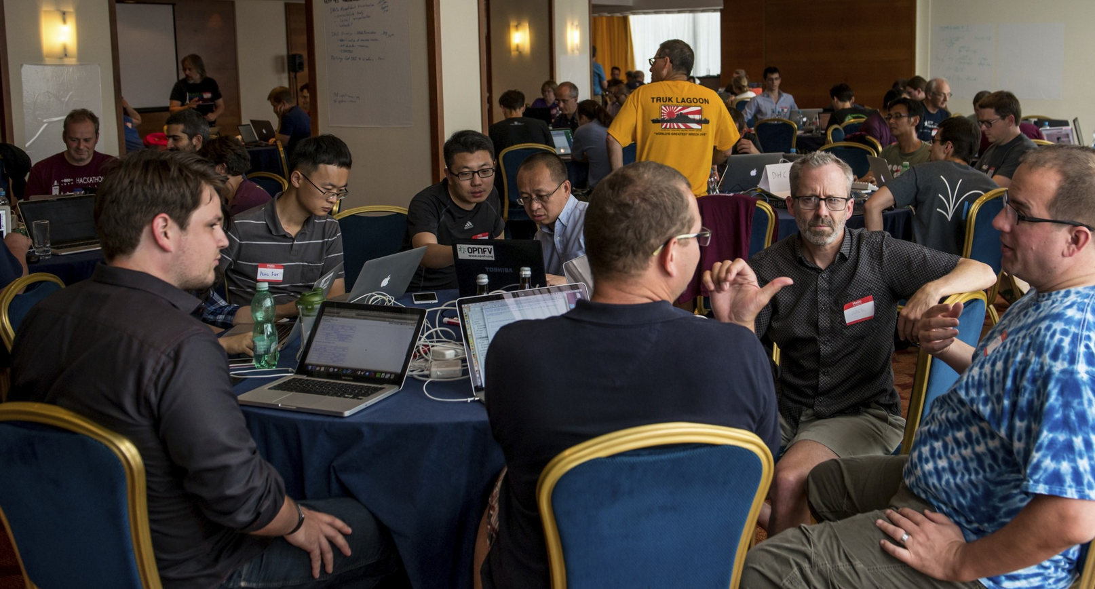
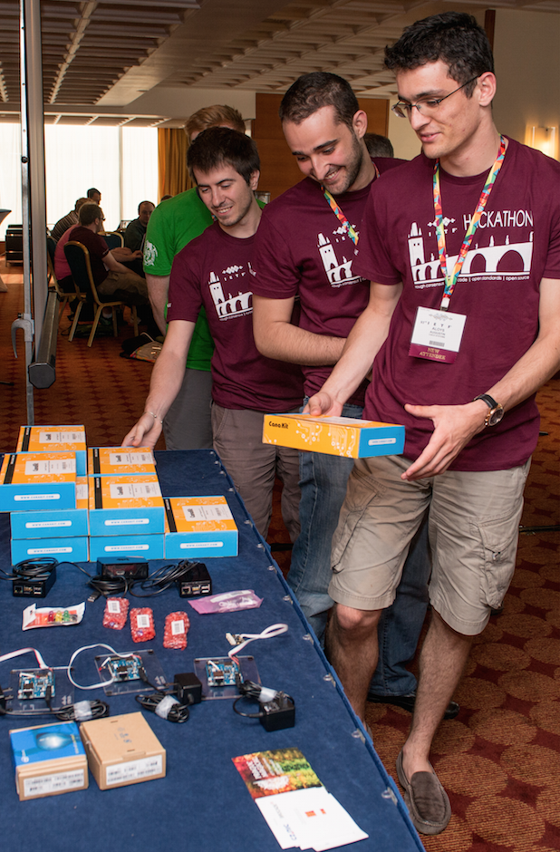
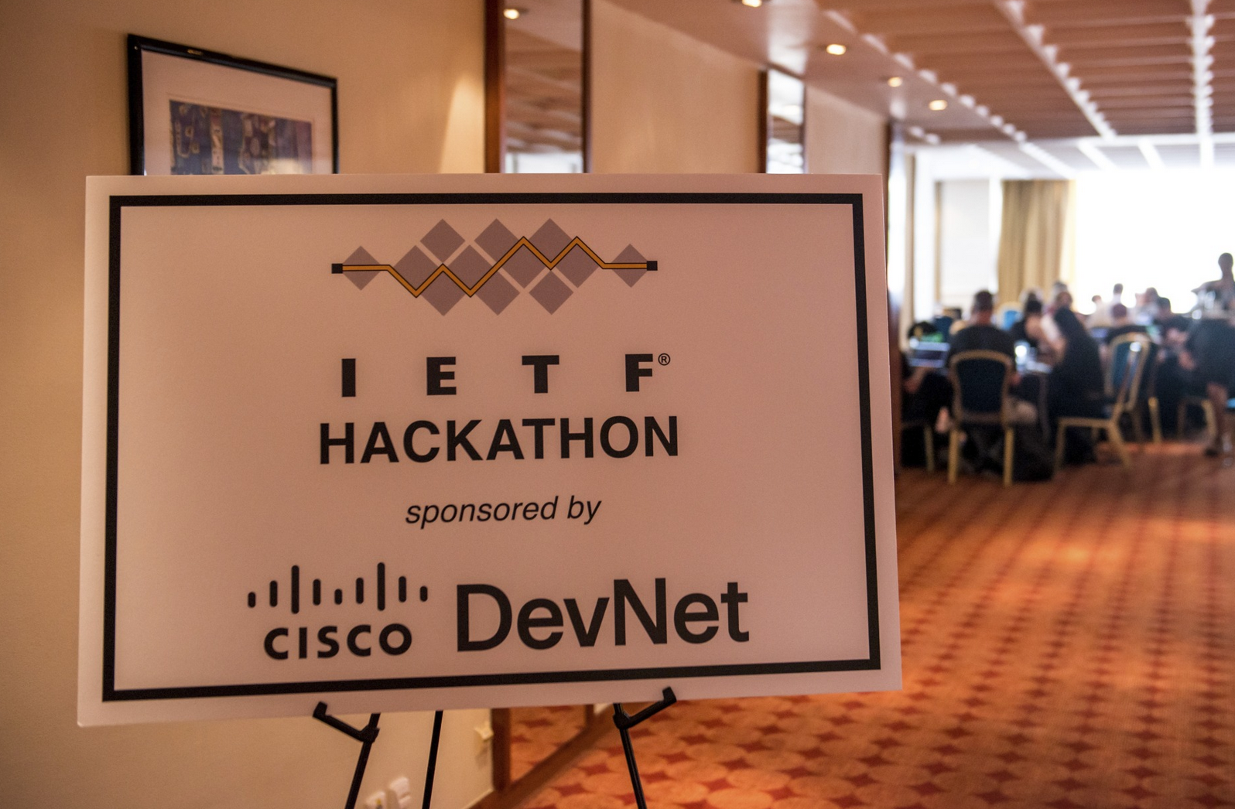
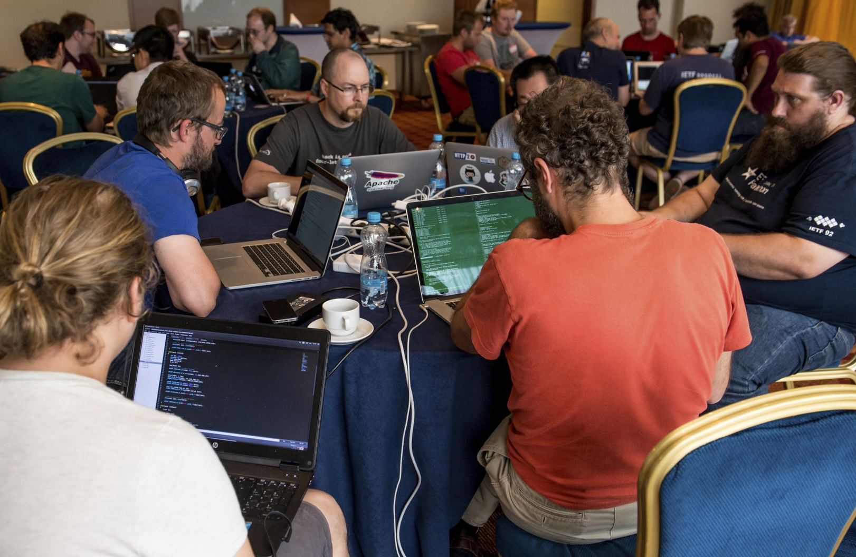
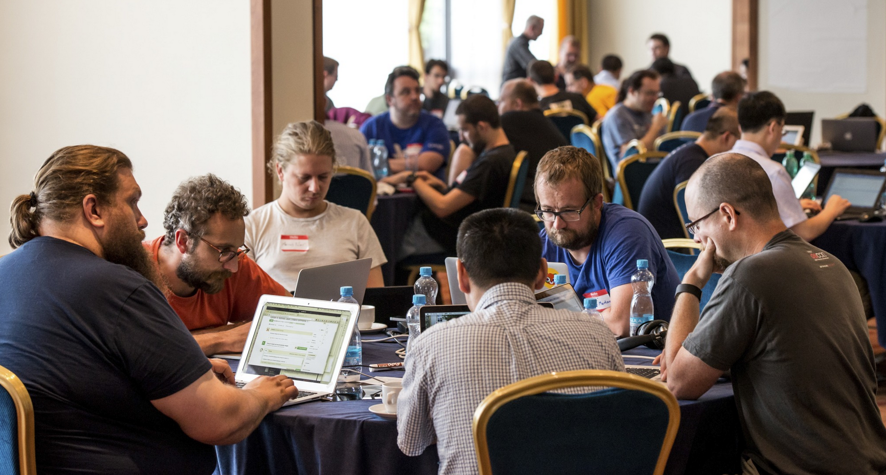
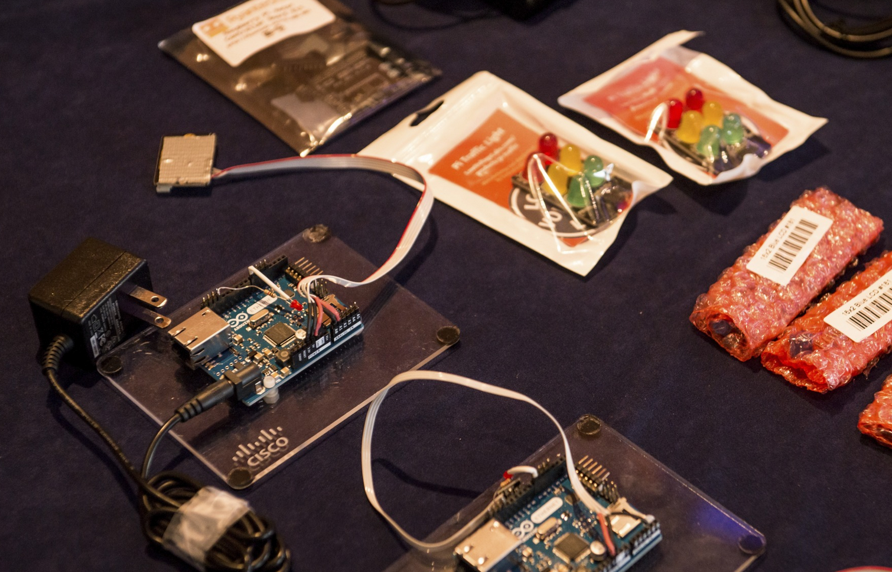
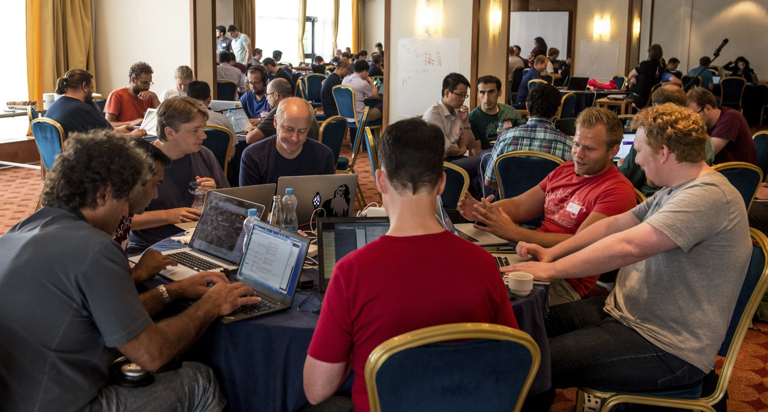
© Stonehouse Photographic / Internet Society

Slide 7
DNS / DNSSEC / DANE / DPRIVE Team
Platform Used
Team Organizations
ACLU, Cloudflare, ISOC,
NLnet Labs, No Mountain,
Salesforce, Sinodun,
Verisign Labs, W3C
Winner of a
Best in Show
Interested folks:
BOF in Istanbul Room following Bits-n-Bites
Projects Developed
DNS-over-TLS privacy – add authentication and forward secrecy
DNSSEC roadblock tester
DNSSEC algorithm visualizer
Algorithm registry fetch tool
TLS DNSSEC chain extension server demo
DEMO
AVAILABLE

Slide 8
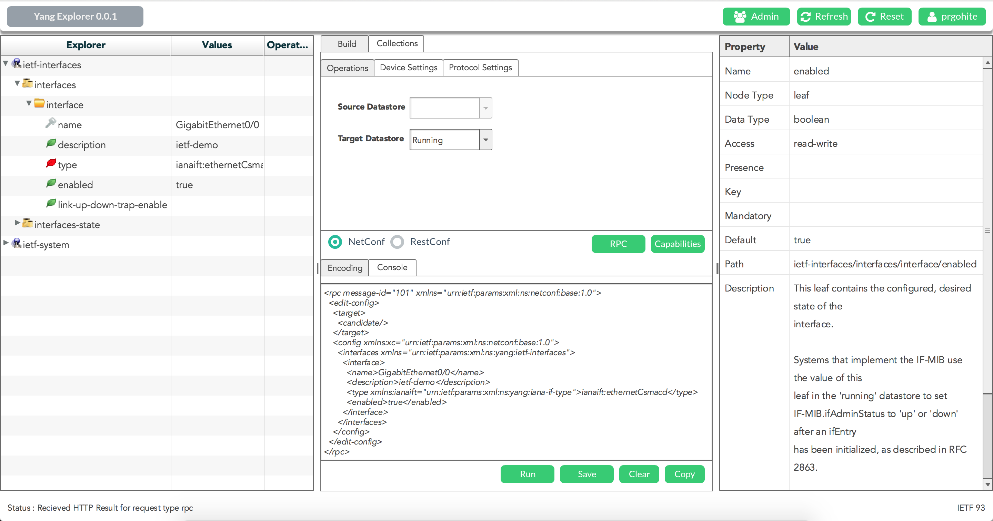
Yang Explorer
Client-Server Web / Desktop app
Browse YANG data models
Inspect properties of nodes
Create and Execute NetConf / RestConf RPCs
XML and JSON encoding
Open Source
coming soon …

Slide 9
#IETFhackathon Photo Contest
Best IETF Hackathon Photo
Post to Twitter
#IETFhackathon
#IETF93

Slide 10
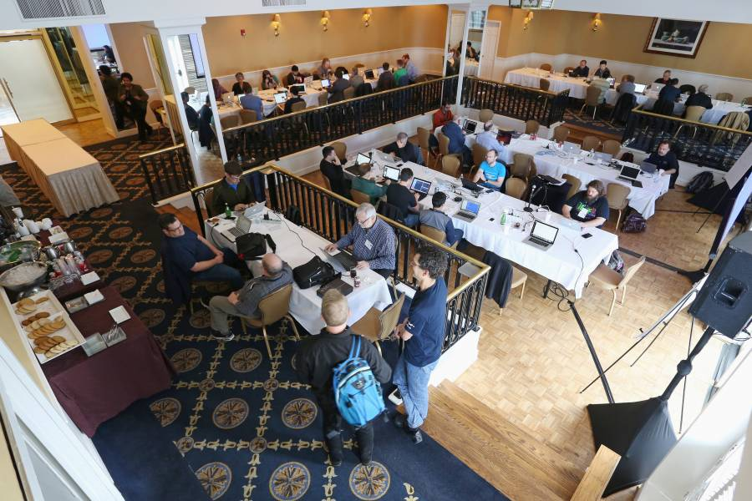
Let’s Get Hacking!

